Slide 1
REDUCING COMMERCIAL AVIATION FATALITIES
Group 14
Emmanuella Eguche
Rehan Daya
Troy Walton
Yiwei Zhou

Slide 2
DESCRIPTION
We had 28 variables and used a dataset with real physiological data from eighteen pilots who were subjected to various distracting events.
The training set includes a set of controlled experiments collected in a non-flight environment, outside of a flight simulator.
The test set (LOFT = Line Oriented Flight Training) consists of a full flight (take off, flight, and landing) in a flight simulator.

Slide 3
DESCRIPTION
The pilots experienced distractions which were intended to induce one of the following three cognitive states:
Channelized Attention (A) is induced in benchmarking by having the subjects play an engaging puzzle-based video game.
Diverted Attention (D) is induced by having the subjects solve a math problem before returning to the monitoring task.
Startle/Surprise (B) is induced by having the subjects watch movie clips with jump scares.

Slide 4
DESCRIPTION
For each experiment, a pair of pilots with their unique id was recorded over time and subject to the CA, DA, or SS states.
Our goal is to predict the probability of each state for each time in the test set. We assume that the non-flight environment is equivalent to a flight simulator.
During experiment CA, one can experience event A or C. During experiment DA, one can experience event A or D and in experiment SS, event A or B. It helps to associate “event” with reaction to the experiment.

Slide 5
VARIABLES
23 of the variables were related to methods of collecting response signals from the body.
20 were EEG nodes on various points of the scalp
1 measured Galvanic Response
1 measured respiration through rise and fall of chest
1 measured heart activity with an electrocardiogram
The remaining 5 variables were crew, seat, experiment, time, and event.

Slide 6
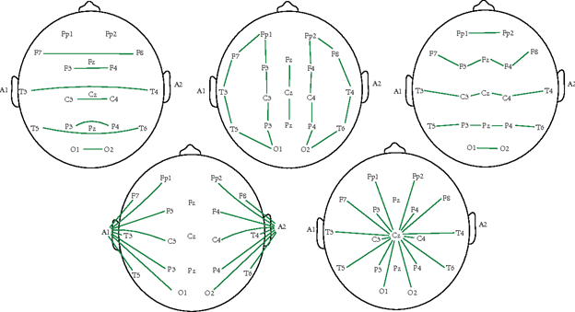
VARIABLES
We tried to understand where each node was placed to figure out why certain nodes would light up during certain reactions. This helped find anomalies and correlations.

Slide 7
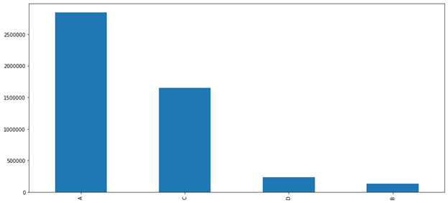
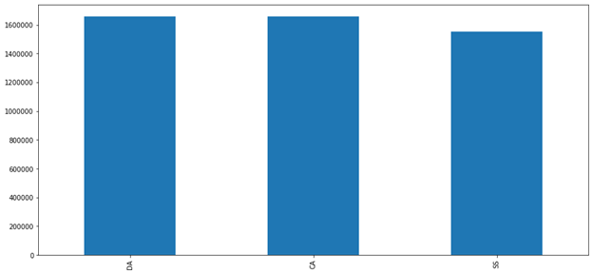
DATA EXPLORATION
Event A occurs most often, aggregated through all experiments
Roughly the same number of observations are made in each experiment

Slide 8
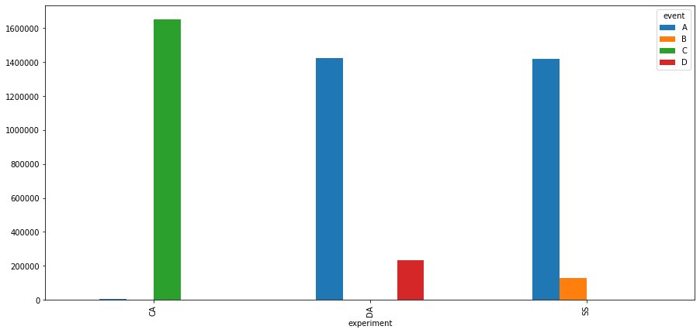
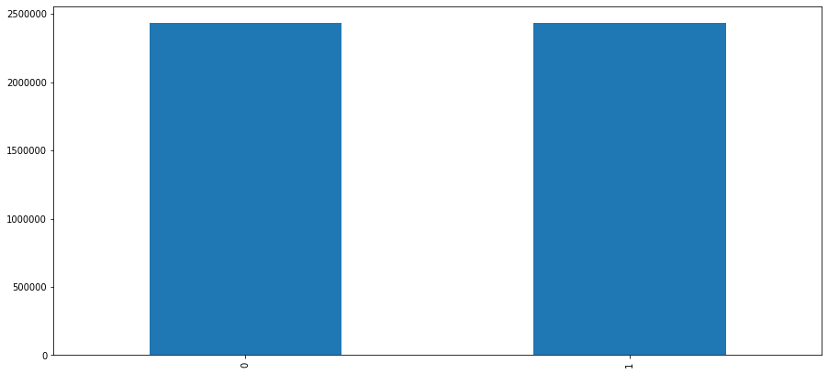
DATA EXPLORATION
Only some events are realized in each experiment
Roughly the same number of observations are made in each seat

Slide 9
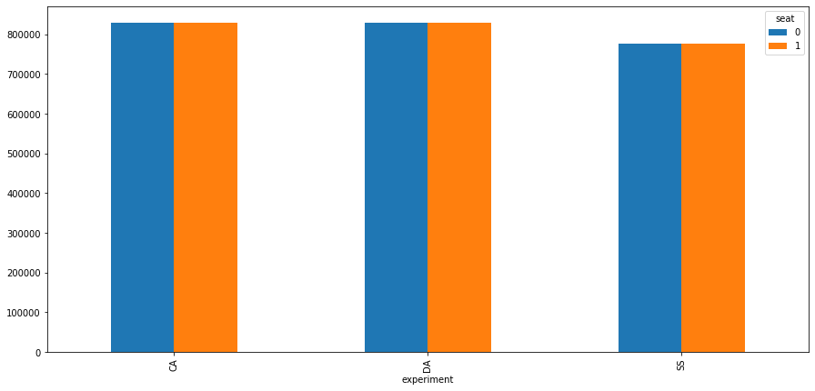
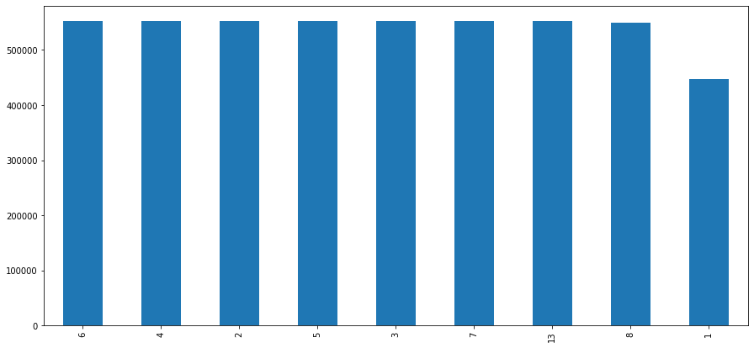
DATA EXPLORATION
Approximately equal amounts of observations in seat 1 and seat 0 are used in each experiment
Oddly there are 9 crews but they are not named chronologically.

Slide 10
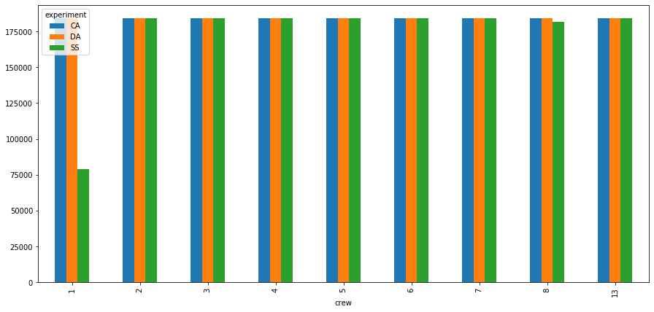
DATA EXPLORATION
We can see that crew 1 is lacking in experiment SS which may cause some bias.

Slide 11
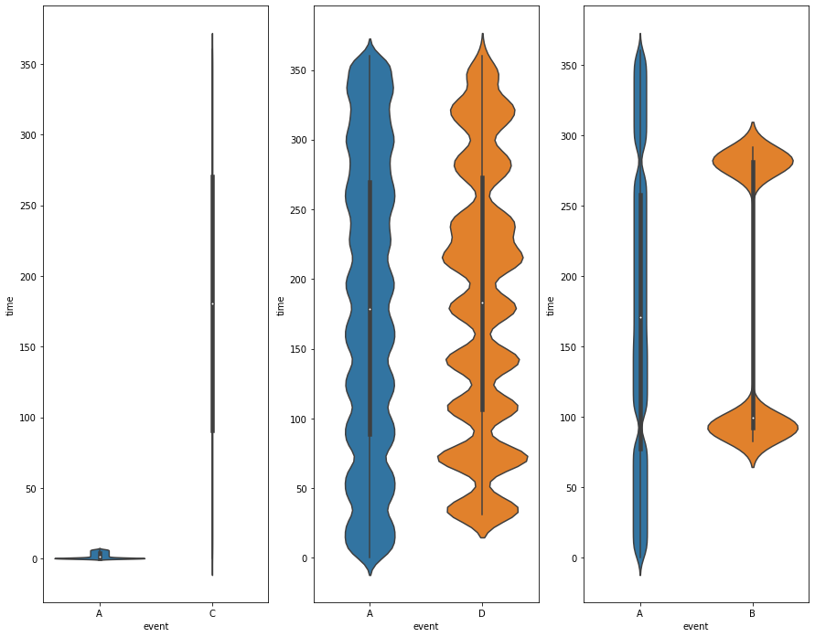
DATA EXPLORATION
● In experiment CA, baseline event A occurs for 0.3431% of the time and event C occurs for 99.6568% of the time.
● In experiment DA, baseline event A occurs for 85.8098% of the time and event D occurs for 14.1901%
● In experiment SS, baseline event A occurs for 91.5779% of the time and event B occurs for 8.4221% of the time.

Slide 12
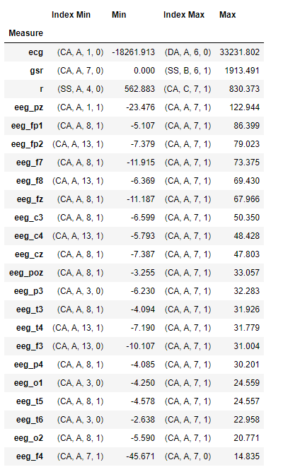
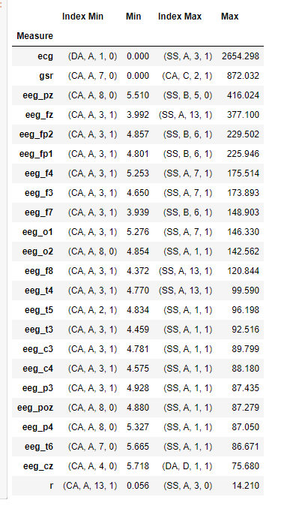
DATA EXPLORATION
Mean Table
Standard Deviation Table
We believe someone in crew 1 may be having absence seizures.
Unsurprisingly, jump scares resulted in higher standard deviations

Slide 13
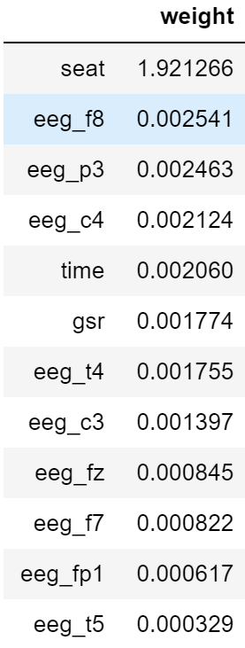
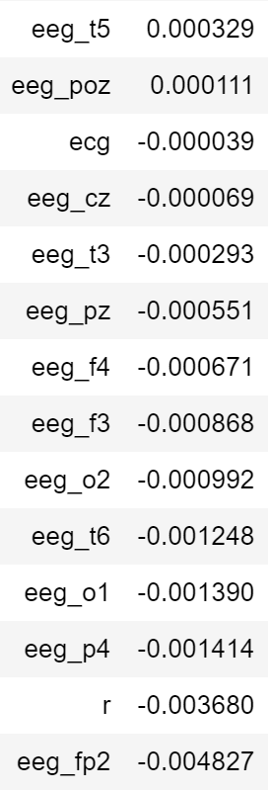
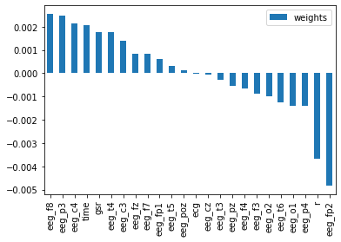
LOGISTIC REGRESSION
Separated train/test datasets with 70/30 ratio.
The accuracy of prediction without looking at the features is: 62.62%

Slide 14
LOGISTIC REGRESSION
Observations
eeg_fp2 and respiration has the most negative weights
a higher rating of respiration and eeg_fp2 means the pilot is less likely to be distracted (higher ⇒ less distracted)
seat = 0/1 has high positive weight ⇒ more likely to be distracted when seat = 1 (right seat).
This corresponds to the pilot on the right seat.
This illustrates why captain is always seated on the left.

Slide 15
LOGISTIC REGRESSION
Observations
eeg_c4, eeg_p3, eeg_f8 have positive weights at around 0.002-0.0025. They are the most predictive factors of pilots' distractedness.
c4 is related to the inhibition of brain alpha waves (high reading from c4 node indicates lack of concentration).
p3 node detects reactivity to external sensory stimulation.
f8 is correlated with frequent judgement control.
On the other hand, time and galvanic skin response also have relatively high weights (the more time into experiment and the more skin response, the more distracted the pilots are.)

Slide 16
TREE MODELS
Depth Limitation | Max. Depth = 2 | Max. Depth = 3 | None
Training accuracy | 61.85% | 63.44% | 100%
Testing accuracy | 61.95% | 63.50% | 99.96%
Testing accuracy w/ Bagging | 61.95%** | 63.50%** | -
Separated training and testing sets with 70:30 split
Best predictors to split the data:
Electrocardiogram signal (ecr)
Galvanic skin response (gsr)
** These values are different than the initial testing accuracies but round to the same number in both instances

Slide 17
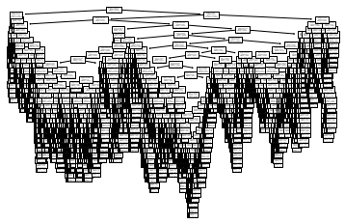
TREE MODELS
To get a sense for the complexity of the model with no depth limitations, see below:

Slide 18
KNN
To utilize models with more neighbors required 100+GB of RAM
We settled for KNN=1 and Kfold=3
98.7% accuracy with runtime of 45 minutes

Slide 19
MODEL COMPARISON
Model | Accuracy | Error | Adjusted R^2
Logistic Regression | / | / | 51.6%
KNN | 98.70% | 1.30% | /
Decision Tree | 99.96% | 0.04% | /

Slide 20
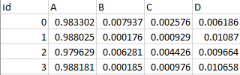
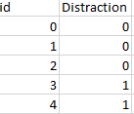
LIMITATIONS
Test and Train dataset combined was ~6GB in raw format
(639,311,792 cells) or 28 columns and 22,832,564 rows
Python utilizes 1 CPU core (non-concurrent) and has no GPU application
4 outputs were required and needed to show probability.
We pivoted and made our output a binary prediction, of 0=No distraction (event A), 1=distraction (event B,C,D).
Kaggle Sample Submission
Binary Output

Slide 21
CONCLUSION
The devices monitoring pilots’ eef_c4, eeg_p3 and eeg_f8 nodes should be employed to detect distractedness.
Pilots on the right seat tend to be more distracted and fall into three abnormal states.
More data on pilots’ basic information such as height, weight, gender and possibly health conditions should be taken into account for better analysis results.
Pilots encountering startle/surprise states tend to suffer from the most fluctuation in eeg readings.

